Slide 1
Memory Organization
Memory Hierarchy
Memory hierarchy in a computer system :
Main Memory : memory unit that communicates directly with the CPU (RAM)
Auxiliary Memory : device that provide backup storage (Disk Drives)
Cache Memory : special very-high-speed memory to increase the processing speed (Cache RAM)

Slide 2
Memory Organization
Multiprogramming
enable the CPU to process a number of independent program concurrently
Memory Management System :
supervise the flow of information between auxiliary memory and main memory
Memory Hierarchy is to obtain the highest possible access speed while minimizing the total cost of the memory system
Register
Cache
Main Memory
Magnetic Disk
Magnetic Tape

Slide 3
Random Access Memory (RAM)
RAM Chips
Static RAM
Consists of Flip-flops to store binary information.
Static RAM is easier to use and having short Read/Write cycles
Used mostly in Cache memory.
Dynamic RAM
Stores binary information in the form of electric charge stored inside the capacitor.
The capacitors are provided by MOS transistors.
Refreshing circuit is required to refresh the memory.
Dynamic RAM offers reduced power consumption and large storage capacity.
It is used to construct main memory.
Typical RAM chip :
128 X 8 RAM : 2⁷ = 128 (7 bit address lines)
Typical ROM chip:
512 X 8 ROM : 2⁹ = 512 (9 bit address lines

Slide 4
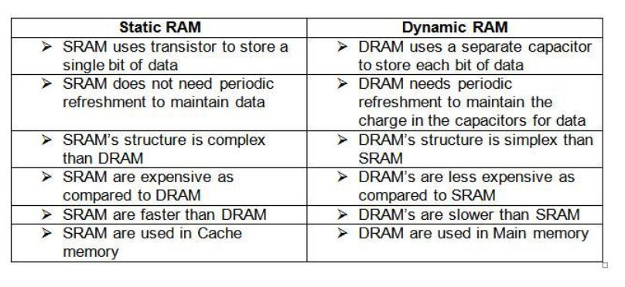
Static RAM Vs Dynamic RAM

Slide 5
MAIN MEMORY
Main Memory
RAM and ROM Chips
Typical RAM chip
Chip select 1
CS1
Chip select 2
CS2
128 x 8
Read
RD
RAM
8-bit data bus
Write
WR
7-bit address
AD 7
CS1 CS2 RD WR
Memory function
State of data bus
0 0 x x
Inhibit
High-impedence
0 1 x x
Inhibit
High-impedence
1 0 0 0
Inhibit
High-impedence
1 0 0 1
Write
Input data to RAM
1 0 1 x
Read
Output data from RAM
1 1 x x
Inhibit
High-impedence
Typical ROM chip
Chip select 1
CS1
Chip select 2
CS2
512 x 8
8-bit data bus
ROM
9-bit address
AD 9

Slide 6
MEMORY ADDRESS MAP
Main Memory
Address space assignment to each memory chip
Example: 512 bytes RAM and 512 bytes ROM
Hexadecimal
address
Address bus
Component
10 9 8 7 6 5 4 3 2 1
RAM 1
RAM 2
RAM 3
RAM 4
ROM
0000 - 007F
0080 - 00FF
0100 - 017F
0180 - 01FF
0200 - 03FF
0 0 0 x x x x x x x
0 0 1 x x x x x x x
0 1 0 x x x x x x x
0 1 1 x x x x x x x
1 x x x x x x x x x
Memory Connection to CPU
- RAM and ROM chips are connected to a CPU
through the data and address buses
- The low-order lines in the address bus select
the byte within the chips and other lines in the
address bus select a particular chip through
its chip select inputs

Slide 7
CONNECTION OF MEMORY TO CPU
Main Memory
Address bus
CPU
16-11
10
9
8
7-1
RD
WR
Data bus
Decoder
3
2
1
0
CS1
CS2
128 x 8
Data
RD
RAM 1
WR
AD7
CS1
CS2
128 x 8
Data
RD
RAM 2
WR
AD7
CS1
CS2
128 x 8
Data
RD
RAM 3
WR
AD7
CS1
CS2
128 x 8
RD
RAM 4
Data
WR
AD7
CS1
1- 7
CS2
512 x 8
8
ROM
Data
9
AD9

Slide 8
Numerical Problems
Q1. a) How many 128x8 RAM chips are needed to provide a memory capacity of 2048 bytes.
b) How any lines of the address bus must be used to access 2048 bytes of memory. How many of these lines will be common to all chips.
c) How many lines must be decoded for chip select? Specify the size of decoders.
Q2. Extend the memory system of Fig.1 to 4096 bytes of RAM and 4096 bytes of ROM. List the memory-address map and indicate what size decoders are needed.
Q3. A computer employs RAM chips of 256x8 and ROM chips of 1024x8. The computer system needs 2K bytes of RAM, 4K bytes of ROM, and four interface units each with four registers. A memory-mapped I/O configuration used. The two highest-order bits of the address bus are assigned 00 for RAM, 01 for ROM, and 10 for interface registers.
How many RAM and ROM chips are needed.
Draw a memory-address map for the system.
Give the address range in hexadecimal for RAM, ROM and interface.

Slide 9
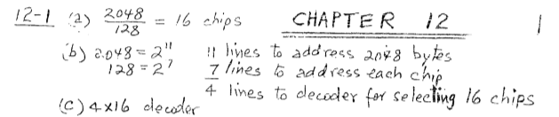
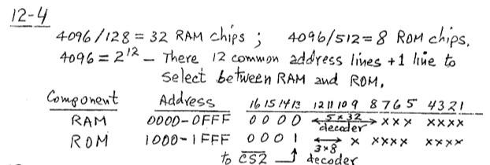

Slide 10
Cache Memory
12-5 Cache Memory
Locality of Reference
the references to memory tend to be confined within a few localized areas in memory
Cache Memory : a fast small memory
keeping the most frequently accessed instructions and data in the fast cache memory
Hit Ratio
the ratio of the number of hits divided by the total CPU references (hits + misses) to memory
hit : the CPU finds the word in the cache
miss : the word is not found in cache (CPU must read main memory)
A computer with cache access time of 100ns, a main memory access time of 1000 ns, a hit ratio of 0.9 is having average access time of 200ns.

Slide 11
Types of Mapping of Cache Memory
Mapping
The transformation of data from main memory to cache memory
1) Associative mapping
2) Direct mapping
3) Set-associative mapping
Associative Memory:
main memory : 32 K x 12 bit word (15 bit address lines)
cache memory : 512 x 12 bit word
CPU sends a 15-bit address to cache
Hit : CPU accepts the 12-bit data from cache
Miss : CPU reads the data from main memory (then data is written to cache)

Slide 12
Associative Memory

Slide 13
Direct Mapping
Direct mapping :
n bit memory address
Tag field (n - k) : Index field (k)
2^{k} words cache memory + 2^{n} words main memory
Tag = 6 bit (15 - 9), Index = 9 bit

Slide 14
Direct Mapping
Direct mapping cache with block size of 8 words :
64 block x 8 word = 512 cache words size

Slide 15
Set-Associative Mapping
Set-associative mapping : (two-way)

Slide 16
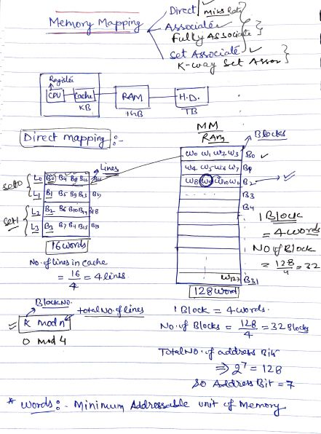

Slide 17
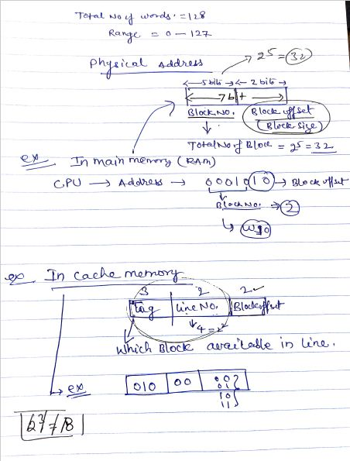

Slide 18
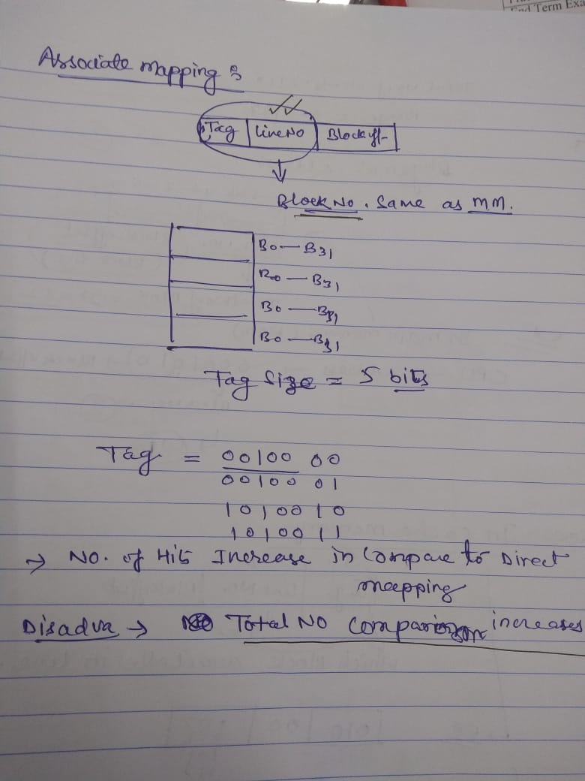

Slide 19
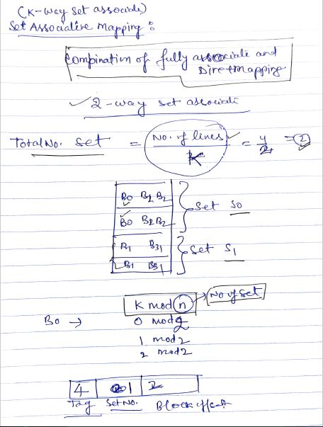

Slide 20
Questions
A two-way set associative cache memory uses blocks of four words. The cache can accommodate a total of 2048 words from main memory. The main memory size is 128Kx32. Formulate all pertinent information required to construct the cache memory. What is the size of cache memory.
A computer has a memory unit of 64Kx16 and a cache memory of 1K words. The cache uses direct mapping with a block size of four words. How many bits are there in the tag, index, block, and words fields of the address format. How many bits are there in each word of cache, and how are they divided into functions? Include a valid bit. How many blocks can the cache accommodate?
The access time of a cache memory is 100ns and that of main memory is 1000ns. It is estimated that 80 percent of the memory requests are for read and the remaining 20 percent for write. The hit ratio for read access only is 0.9. A write-through procedure is used. What is the average access time of the system considering only memory read cycles. What is the average access time of the system for both read and write requests. What is the hit ratio considering the write requests also.

Slide 21
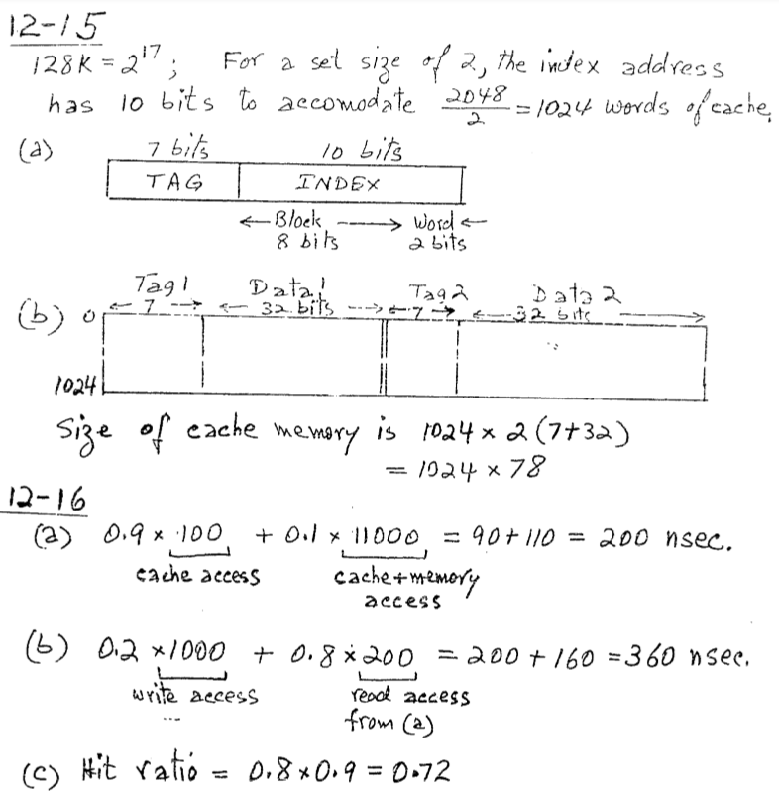
Answer

Slide 22
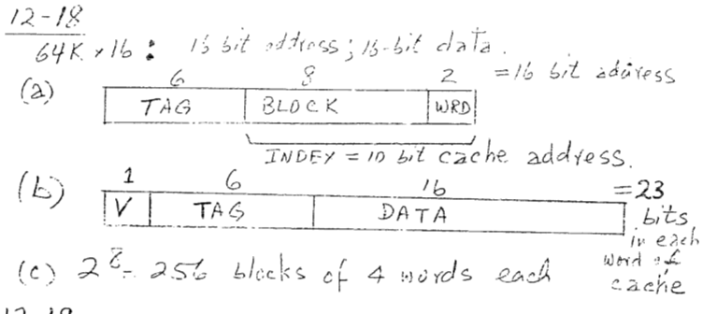
Answer

Slide 23
Replacement Algorithm : cache miss or full
1) LRU (Least Recently Used):
2) Random Replacement:
3) FIFO (First-In First-Out) :
Writing to Cache :
1) Write-through :
2) Write-back :
Cache Initialization
Cache is initialized :
1) When power is applied to the computer
2) When main memory is loaded with a complete set of programs from auxiliary memory
3) Cache is initialized by clearing all the valid bits to 0.
Valid bit
Indicate whether or not the word contains valid data

Slide 24
Virtual Memory
VIRTUAL MEMORY
Give the programmer the illusion that the system has a very large memory,
even though the computer actually has a relatively small main memory
Address Space(Logical) and Memory Space(Physical)
address space
memory space
virtual address
(logical address)
Mapping
physical address
address generated by programs actual main memory address
Address Mapping
Memory Mapping Table for Virtual Address -> Physical Address
Virtual address
Virtual
Memory
Main memory
address
mapping
address
Main
register
table
register
memory
Physical
Address
Memory table
Main memory
buffer register
buffer register

Slide 25
ADDRESS MAPPING
Virtual Memory
Address Space and Memory Space are each divided
into fixed size group of words called blocks or pages
1K words group
Page 0
Page 1
Address space
N = 8K = 2¹³
Page 2
Block 0
Page 3
Memory space
M = 4K = 2¹²
Block 1
Page 4
Block 2
Page 5
Block 3
Page 6
Page 7
Organization of memory Mapping Table in a paged system
Page no.
Offset
1 0 1
0 1 0 1 0 1 0 0 1 1
Virtual address
Table
Presence
address
bit
000
0
Main memory
001
11
1
Block 0
010
00
1
Block 1
011
0
0 1
0 1 0 1 0 1 0 0 1 1
Block 2
100
0
Main memory
Block 3
101
01
1
address register
Memory page table
110
10
1
111
0
MBR
01
1

Slide 26
PAGE REPLACEMENT ALGORITHMS
Virtual Memory
FIFO
Reference string
7
0
1
2
0
3
0
4
2
3
0
3
2
1
2
0
1
7
0
1
7
7
7
2
2
2
4
4
4
0
0
0
7
7
7
0
0
0
3
3
3
2
2
2
1
1
1
0
0
1
1
1
0
0
0
3
3
3
2
2
2
1
Page frames
FIFO algorithm selects the page that has been in memory the longest time
Optimal Replacement (OPT) - Lowest page fault rate of all algorithms
Replace that page which will not be used for the longest period of time
Reference string
7
0
1
2
0
3
0
4
2
3
0
3
2
1
2
0
1
7
0
1
7
7
7
2
2
2
2
2
7
0
0
0
0
4
0
0
0
1
1
3
3
3
1
1
Page frames

Slide 27
PAGE REPLACEMENT ALGORITHMS
Virtual Memory
LRU
- OPT is difficult to implement since it requires future knowledge
Replace that page which has not been
used for the longest period of time
Reference string
7
0
1
2
0
3
0
4
2
3
0
3
2
1
2
0
1
7
0
1
7
7
7
2
2
4
4
4
0
1
1
1
0
0
0
0
0
0
3
3
3
0
0
1
1
3
3
2
2
2
2
2
7
Page frames

Slide 28
A virtual memory system has an address space of 8K words, a memory space of 4K words and page & block sizes are of 1K words. The following page is referenced in memory: 4 2 0 1 2 6 1 4 0 1 0 2 3 5 7. Determine the four pages that are resident in main memory after each page reference change if page replacement algorithm is : FIFO, LRU, Optimal.
An address space is specified by 24 bits and the corresponding memory space by 16 bits. How many words are there in the address space. How many words are there in the memory space. If a page consists of 2K words, how many pages and blocks are there in the system?

Slide 29
Secondary Storage

Slide 30
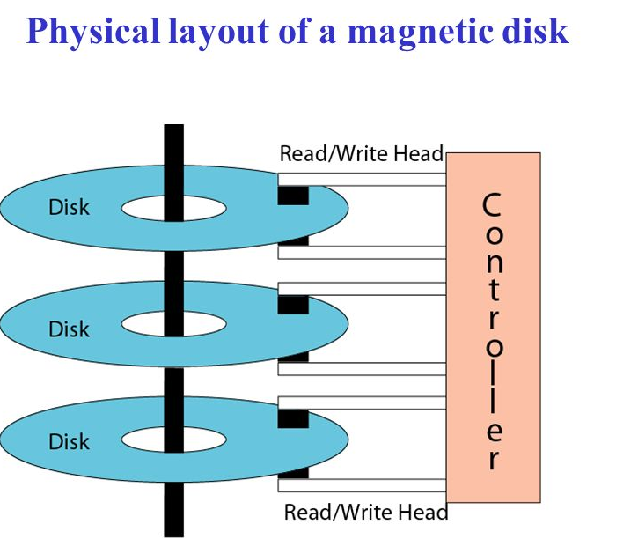
Hard-disk Organization

Slide 31
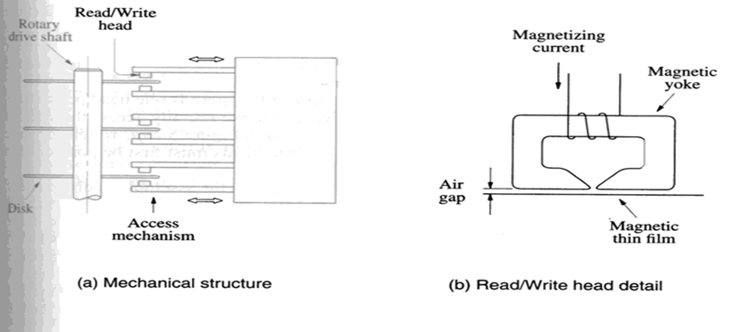
Magnetic Hard Disks

Slide 32
Organization of Data on a Disk
Sector 3, track
n
Sector 0, track 1
Sector 0, track 0
Organization of one surface of a disk.
Access Time:
Seek time: Time required to move the R/W head to the proper track.
Rotational latency: Time required to move the starting position of sector under the read/write head.

Slide 33
Optical Disks
Aluminum
Acrylic
Label
Pit
Land
Polycarbonate plastic
(a) Cross-section
Pit
Land
Reflection
Reflection
No reflection
Source
Detector
Source
Detector
Source
Detector
(b) Transition from pit to land
0
1
0
0
1
0
0
0
0
1
0
0
0
1
0
0
1
0
0
1
0
(c) Stored binary pattern

Slide 34
Optical Disks
CD is 120 mm in diameter.
15 mm hole in the center.
Data stored on tracks that cover the area from 25 mm radius to 58 mm radius.
There are more than 15,000 tracks.
Spiral structured were unraveled will be more than 5 KM long !
Basic access speed is 1X, 75 sectors per second.
CD-RW:
Consists of alloy of silver, indium, antimony & tellurum.
When heated above 500c, it absorbs light.(Amorphous state)
When heated to 200c, it goes in crystalline state and allows light to pass through.

Slide 35
Magnetic Tape Systems
File
File
mark
File
mark
•
•
•
•
•
•
•
•
7 or 9
bits
File gap
Record
Record
Record
Record
gap
gap
Figure 5.33. Organization of data on magnetic tape.

Slide 36
Traditional Memory Architecture
Processor
Memory
k
-bit
address bus
MAR
n
-bit
data bus
Up to 2
k
addressable
MDR
locations
Word length =
n
bits
Control lines
R
/
W
( , MFC, etc.)
Figure 5.1. Connection of the memory to the processor.

Slide 37
Internal Organization of Memory Chips
b
7
b
′
7
b
1
b
′
b
b
′
1
0
0
W
0
•
•
•
FF
FF
A
0
W
1
•
•
•
A
1
Address
Memory
decoder
•
•
•
•
•
•
•
•
•
•
•
•
•
•
•
•
•
•
cells
A
2
A
3
W
15
•
•
•
16 words of 8 bits each: 16x8 memory org..
It has 16 external connections: addr. 4, data 8, control: 2, power/ground: 2
Sense / Write
Sense / Write
Sense / Write
R
/
W
circuit
circuit
circuit
CS
Data input
b
7
b
1
b
0
/output lines:
Figure 5.2. Organization of bit cells in a memory chip.

Slide 38
A 2D Memory Chip
5-bit row
address
W
0
W
1
5-bit
32
X
32
decoder
memory cell
array
W
31
Sense
/
Write
circuitry
10-bit
address
32-to-1
output multiplexer
R
/
W
and
CS
input demultiplexer
5-bit column
address
Data
input/output
Figure 5.3. Organization of a 1K × 1 memory chip.

Slide 39
Some examples
For example:
4MB chip may have 512K X 8 organization, 19 address and 8 data lines.
Also 2^32 generates—4,294,967,296 values. Can address 4GB locations.

Slide 40
Static RAM
The circuits are capable of retaining their state as long as power is applied.
Figure 5.4. A static RAM cell.
b
b
′
T
1
X
Y
T
2
Word line
Bit lines

Slide 41
Dynamic RAMs
Static RAMs are fast, but they cost more area and are more expensive.
Dynamic RAMs (DRAMs) are cheap and area efficient, but they can not retain their state indefinitely – need to be periodically refreshed.
Bit line
Word line
T
C
Figure 5.6. A single-transistor dynamic memory cell

Slide 42
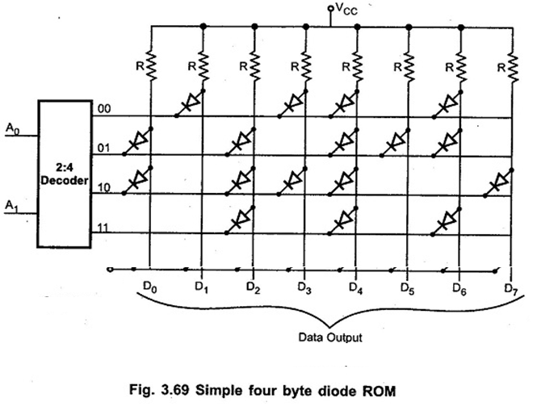
ROM Technology

Slide 43
Read-Only-Memory (PROM)
Bit line
Word line
T
Not connected to store a 1
P
Connected to store a 0
Figure 5.12. A ROM cell.

Slide 44
Read-Only-Memory
PROM: Programmable ROM
Programmability is achieved by inserting a fuse at point P.
EPROM: Erasable, Programmable ROM
Here, at point P special transistor is used which works as normal transistor or disabled transistor.
EEPROM: Electrically Erasable ROM.
It can be programmed and erased electrically by applying appropriate voltages.

Slide 45
Input-Output Organization
Peripheral Devices: Input & Output devices attached to computer are called Peripheral.
Input Devices:
Keyboard, Optical devices: Card reader, Bar code reader etc.
Magnetic Input Devices: Magnetic stripe reader
Screen Input Devices: Touch screen, Light pen etc.
Output Devices:
Keyboard, Optical devices: Card reader, Bar code reader etc.
Peripherals that provide auxiliary storage are magnetic tape and magnetic disk.
Input and output devices communicate alphanumeric information by using ASCII 7bit code.
To use computer efficiently, large number of programs and data must be prepared in advance for execution with computer.
Output Devices: CRT, Printer
.

Slide 46
Input-Output Interface
I/O interface provides a method for transferring information between internal storage and external I/O devices.
The purpose of interfacing are as follows:
Peripherals are electromechanical & electromagnetic devices and are interacting with electronics devices(CPU).
Data transfer rate of peripherals is usually slower than transfer rate of CPU.
Data codes and formats in peripherals differ from word format in CPU
Operating modes of peripherals are different from each other and each one must be controlled without disturbing other.
To resolve these differences, computer system includes Interface units between CPU and peripherals to supervise and synchronize all input and output transfers.

Slide 47
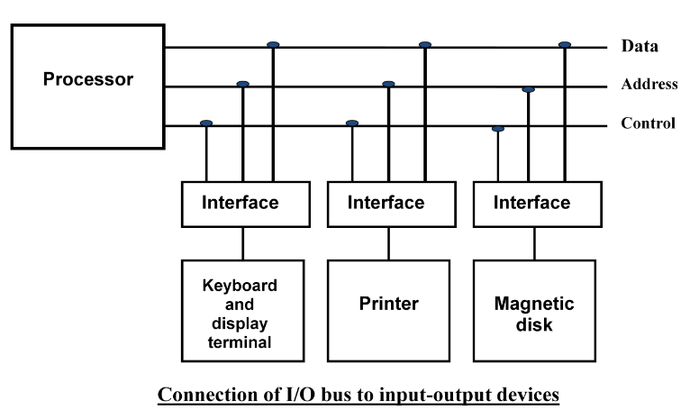
Input-Output Interface
Each peripheral has its own controller that operates a particular electromechanical device.
To communicate with a particular device, the processor places a device address on the address lines.

Slide 48
Input-Output Interface
When the interface detects it own address, it activates path between bus lines and the device.
At the time address is made available in address lines, the processor provides function code(I/O command) in the control lines.
Types of I/O command:
Control command: To activate and inform what to do.
Status command: To test various status conditions.
Data Output data: It causes the transfer of data from bus into one of its registers.
Data Input Command: Interface receives data from peripheral and places them on buffer register where it is put into data lines.

Slide 49
I/O versus Memory Bus
In addition to communicating to I/O, processor must also communicate with memory unit.
There are three ways that computer buses can be used to communicate with memory and I/O:
Use two separate buses, one for memory and one for I/O. (IOP)
Use one common bus for both memory and I/O but have separate control lines for each. (Isolated I/O)
Use one common bus for memory and I/O with common control lines. (Memory Mapped I/O)

Slide 50
Isolated I/O
The distinction between memory and I/O transfer is made through separate read and control lines.
I/O read and I/O write are enabled during I/O transfer and Memory read/write are enabled during memory transfer.
In the isolated I/O configuration, CPU have distinct input and output instructions where each of it will be associated with address of the interface register.
When the CPU fetches and decodes the I/O instruction, it places the address associated with the instruction on the common address lines and enables I/O read or I/O write control line.
When the CPU fetches and decodes the Memory instruction, it places the address associated with the instruction on the common address lines and enables Memory read or Memory write control line.
The isolated I/O method isolates memory and I/O addresses.

Slide 51
Memory Mapped I/O
Here the same address space is used for both memory and I/O. The computer treats interface register as a part of memory system.
The assigned address cannot be used for storing memory words, which reduces memory address range available.
In a memory-mapped I/O organization, there are no specific, input or output instruction.
CPU manipulate I/O data residing in interface registers with the same instruction used to manipulate memory words.
Load and store instruction used for reading/writing from memory and can be use for input or output data from I/O instruction.
With memory-mapped I/O all instructions that refer to memory are also available for I/O.

Slide 52
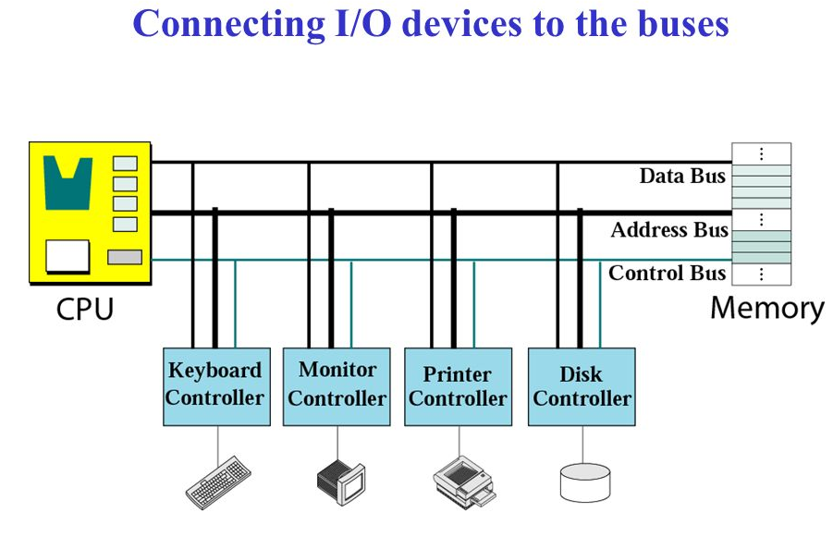
Memory Mapped I/O

Slide 53
Modes of Transfer
Data transfer between the CPU and the I/O devices may be handled in variety of modes. Some modes use the CPU as an intermediate path and others transfer the data directly to and from the memory unit.
Data transfer to and from peripherals may be handled in three ways:
Programmed I/O
Interrupt-initiated I/O
Direct Memory Access (DMA)

Slide 54
Programmed I/O
Programmed I/O operations are the result of I/O instructions. Each data item transfer is initiate by an instruction in the program.
Usually the transfer is to and from a CPU register and peripheral. Other instructions are needed to transfer data between memory and CPU.
Once a data transfer is initiated, the CPU is required to monitor the interface to see when a transfer can again be made.

Slide 55
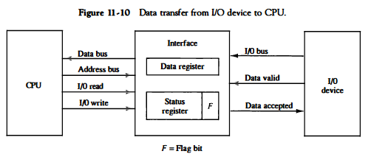
Programmed I/O

Slide 56
Interrupt Initiated I/O
In the programmed I/O CPU stays in program loop until the I/O indicates that it is ready for data transfer.
This is time consuming process since it makes CPU busy needlessly.
This can be avoided by using an interrupt facility.
When the interface determines that device is ready for data transfer, it generates an interrupt request.
Upon detecting external interrupt signal, the CPU momentarily stops the task it is processing.
It then branches to fulfill the I/O request and return to the original task.
Based on the concept of Priority Interrupt.

Slide 57
Direct Memory Access (DMA)
The transfer of data between a fast storage device such as magnetic disk and memory often limited to the speed of CPU.
Removing the CPU and letting the peripheral device manage the memory bus directly improve speed of transfer.
Such transfer technique is called Direct Memory Access (DMA).
A DMA controller takes over the buses to manage the transfer directly between I/O device and memory.
During DMA transfer, the CPU is idle and has no control over memory buses.
By using Bus Request(BR) and Bus Grant(BG) the buses are released to DMA controller.

Slide 58
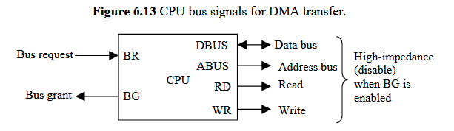
DMA
Data transfer ways:
Burst Transfer: Here number of words are transferred in a block. Example: Magnetic disk.
Cycle stealing: Allows the DMA controller to transfer one data word at a time after it must return the control of buses to CPU.

Slide 59
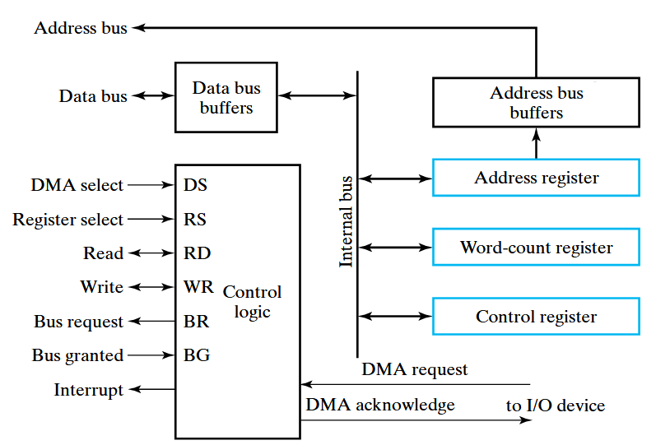
DMA Controller

Slide 60
Initialization of DMA
The CPU initializes the DMA by sending the following information through the data bus.
The starting address of the memory block where data are available(for read) or where data are to be stored(for write).
The word count, which is the number of words in the memory block.
Control to specify the mode of transfer such as read or write.
A control to start the DMA transfer.

Slide 61
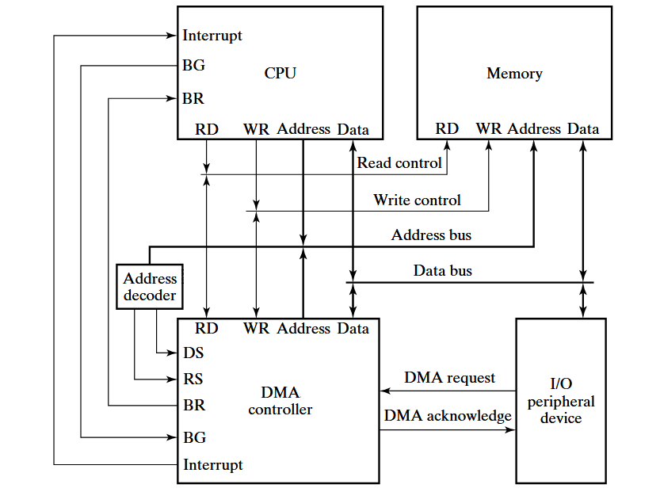
DMA Transfer in a computer system

Slide 62
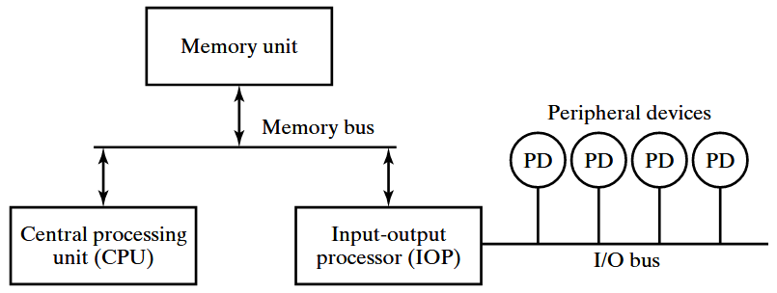
Input-Output Transfer (IOP)

Slide 63
Input-Output Transfer (IOP)
An IOP takes care of input and output tasks.
IOP is similar to CPU except IOP can fetch and execute an I/O instruction.
CPU is usually assigned task of initiating the I/O program and thus IOP.
The CPU is assigned the task of initiating all operations, but I/O instructions are executed in IOP.
When an I/O operation is required, the CPU informs the IOP where to find the I/O program and then leaves the transfer details to the IOP.
CPU instructions also test I/O status conditions needed for making decisions on various I/O activities.
IOP is also responsible of taking care of data synchronization, formats etc between CPU and I/O devices.
In most computers CPU is master and IOP is slave.
The IOP typically asks for CPU attention by means of Interrupt.

Slide 64
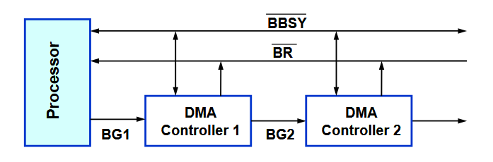
Bus Arbitration
The device that is allowed to initiate data transfers on the bus at any given time is called Bus master.
Bus arbitration is the process by which the next device becomes Bus master and will do the data transfer.
Two approaches: Centralized Arbitration and Distributed Arbitration.
Centralized Arbitration

Slide 65
Types of Interrupt
Major types of Interrupt are:
External Interrupt: It comes from I/O devices, from timing device, or from any other external source. Example that cause
Internal Interrupt: It includes register overflow, invalid operation code, stack overflow etc.
Software Interrupt or Hardware Interrupt: External and Internal interrupts are initiated from signals that occur in the hardware of the CPU. A software interrupt is initiated by executing an instruction.
Priority Interrupt: In case several sources will request service simultaneously, in this case system must decide which device to service first. For ex: Polling, Daisy Chain.

Slide 66
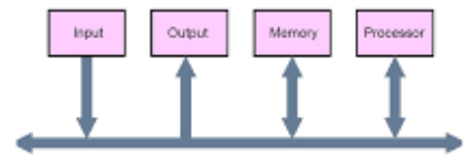
Buses
Data Bus: Bi-directional and transfers data.
Address Bus: Uni-directional and sends the address.
Control Bus: R/W, BR,BG etc.
Bus Structure: Single bus

Slide 67
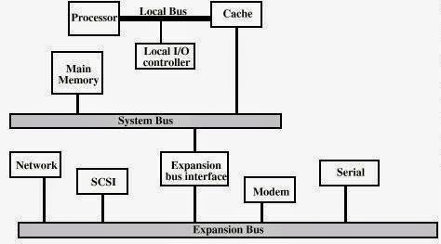
Buses
Bus Structure: Multi bus

Slide 68
Synchronous or Asynchronous Data Transfer
Internal operations in a digital system are synchronized by means of clock pulses supplied by common pulse generator.
If the registers in the interface share a common clock with the CPU registers, the transfer is synchronous.
Asynchronous data transfer requires that control signals be transmitted between communicating units to indicate the time at which data is being transmitted.
Asynchronous data transfer can be accomplished by Strobe & Handshaking.

Slide 69
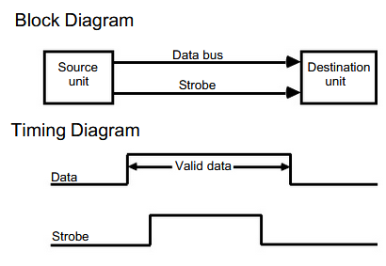
Strobe Control
Strobe control:
It employs single control line.
It can be activated either by source or destination unit.

Slide 70
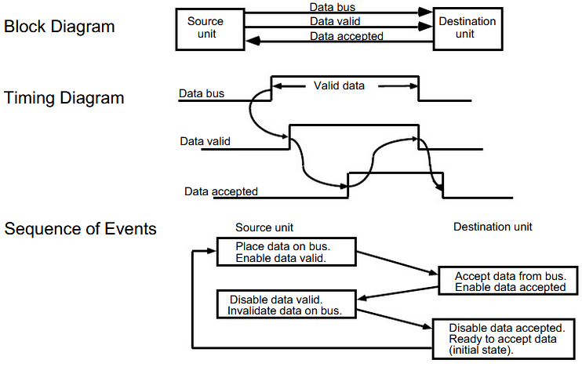
Handshaking

